Slide 1
ABS Business Plan
Presented to Sixth Street
Hong Fan
Mar 2023

Slide 2
ABS Overview
Sector Review
Installment Loan Analytics
Agenda
ABS overview
ABS Themes as of Mar 2023
Sector breakdown and spread context
Sample portfolio construction
Sector review
Subprime Auto
Consumer Loan
Installment loan analytics case study
Problem description and approach
Roll rate modeling and cashflow forecast

Slide 3
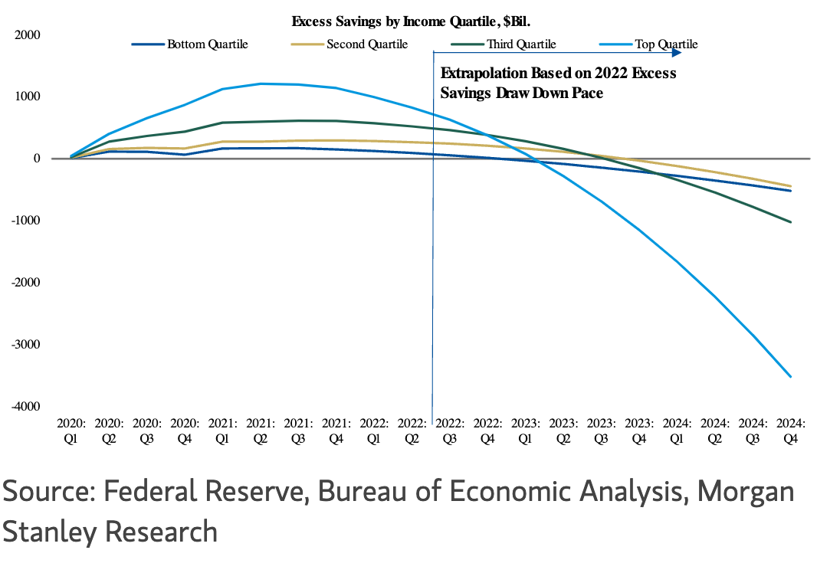
ABS Overview
Sector Review
Installment Loan Analytics
ABS Overview - ABS Theme
ABS Overview - Sector breakdown and spread context
ABS Overview - Sample portfolio construction
ABS Themes
Recent commercial banking system turmoil posts real risk for esoteric asset classes
Lenders (and even borrowers, e.g small biz owners) partner with smaller banks. Banking system turmoil translates to real business risk for them
Banking system turmoil compounded with hiking cycle make access to capital for lenders even harder
On the flip side, good set up for private credit entrance / expansion
Almost across all ABS sectors, performance deterioration (worse than 18/19) observed
Inflation hit disproportionately near-prime and subprime borrowers. Debt heavy median income consumer is struggling with affordability despite of low unemployment (savings rate better indicator though)
Correspondingly, ABS cusip bonds seen sell off and downgrade risk is real (already happening)
On the flip side, picking origination vintages and issuers based on deeper credit (re) underwriting is rewarded
Elsewhere, opportunities at
Longer duration and higher quality collateral deal sub paper
Front pay & underperforming deal / name (UPSPT)

Slide 4
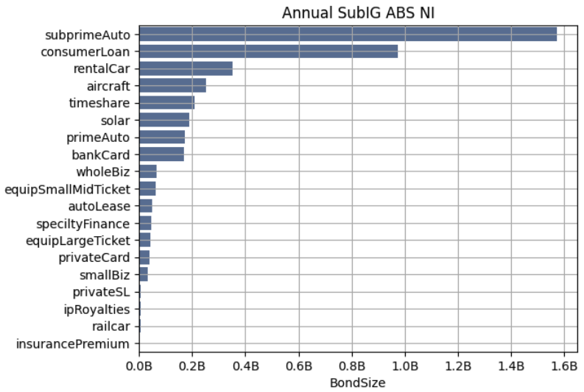
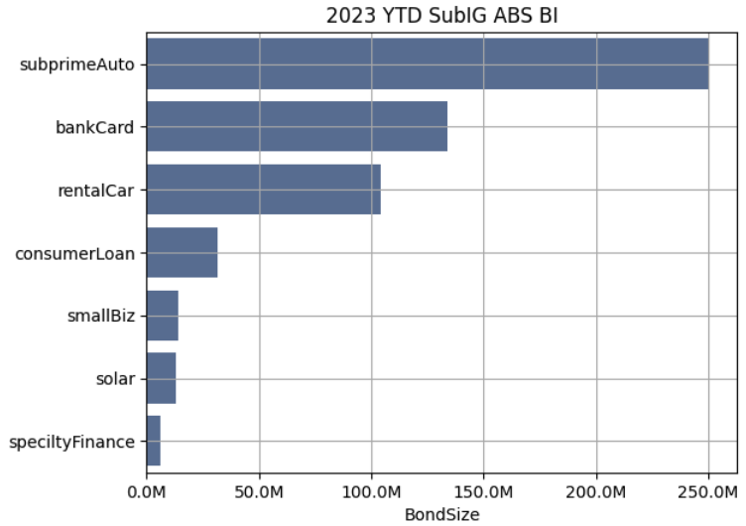
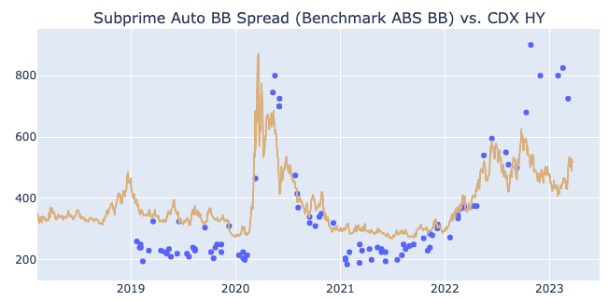
ABS Overview
Sector Review
Installment Loan Analytics
ABS Overview - ABS Theme
ABS Overview - Sector breakdown and spread context
ABS Overview - Sample portfolio construction
Historically ABS sub IG (BB/B) mostly come from Subprime Auto, Consumer Loan
2023 YTD Subprime Auto supplies $250mm sub IG (most), while Consumer Loan BB dwindled due to stacked headwind
Besides above sectors, other sectors sub IG worth looking: Small Biz (high excess spread, super short collat), RentalCar (neutral)
Cautious on sub sectors (though sizable): bank card (too concentrated on name Mercury), Solar (WAC / discount rate too tight, not enough to cover credit worsening and debt cost)
ABS sub IG cash bond, along with other SP sectors, underperform CDX HY lately
Selloff across sectors, regardless of tested asset class (auto), credit cohort (solar mh700s fico) and duration
Sub IG Spread levels across sectors are at lest 2x of pre covid level
Picking origination vintages and issuers based on deeper credit underwriting is rewarded (performance dispersion observed)

Slide 5
ABS Overview
Sector Review
Installment Loan Analytics
ABS Overview - ABS Theme
ABS Overview - Sector breakdown and spread context
ABS Overview - Sample portfolio construction
Sector | Ratings | Size | WAL | Spread | Yield | Notes
Subprime Auto | BB | $70mm | 4 | 800 | 11.5% | selected issuer seasoned + less seasoned
Consumer Loan | BBB | $10mm | 5 | 800 | 11.5% | Higher credit score player less seasoned
Consumer Loan | BBB | $10mm | 2 |  | 8.5% | Seasoned A/B cut front pay senior paper
Rental Car |  | $10mm | 5 | 650 | 10% | Aesop and Hertz lower capital stack
Small Biz |  | - |  |  |  | Worth watching (super short collat and thick excess spread) pass for now as revolving pool and recent commercial banking system turmoil Liquidity thin
Solar |  | - |  |  |  | Higher credit score player But WAC / specified discount rate too tight
Total |  | $100mm | 4 |  | ~11.3%

Slide 6
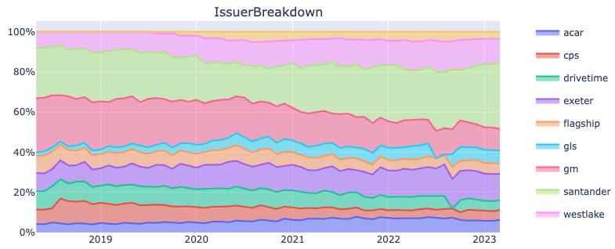
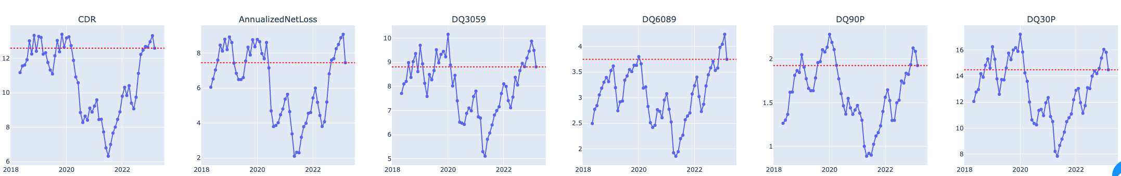
ABS Overview
Sector Review
Installment Loan Analytics
Sector Review – Subprime Auto
Sector Review – Consumer Loan
Subprime Auto Credit Trend
Credit worsening since 2022 from any metrics
Worsening trend slowing down in 2023 Q1
2023 March remit just came out. CDR dropped, as well as early DQ bucket
But needs more data points to approve, as tax return might temporarily help
Manheim used car index still elevated (m200s vs pre covid mh100s)
Potentially posts risk for severity moving from current level to m60s or 70s
Though overall collateral performance worsening and selloff seen across capital stack, performance dispersion is observed across issuer → BB tranches opportunity set (I + 800 – 1100 area)

Slide 7
ABS Overview
Sector Review
Installment Loan Analytics
Sector Review – Subprime Auto
Sector Review – Consumer Loan
Subprime Auto Sub IG Opportunity Set
Subprime Auto sub IG paper in BB and single B rated
$7bn OF paper from 2017 to 2022, and CF at $5+
While single B rated is at $1bn size
upgrade / de-lever reduced the BB / B opportunity set, though still sizable (combined at $3+ bn)
Vintage 2020 / 2021 / 2022 remains the opportunity set
Remaining BB /B Bond basically not started to pay down yet (almost), with overall bond Factor close to 100%
Sub IG BB CE build
2020 /2021 vintage BB on average built into single A Att
2022 vintage BB Att half way between BB and single A
Kick out all upgraded IG bonds

Slide 8
ABS Overview
Sector Review
Installment Loan Analytics
Sector Review – Subprime Auto
Sector Review – Consumer Loan
Subprime Auto Sub IG Opportunity Set
BB / B bond is quite concentrated in terms of issuer. Top 10 issuer consists of over 85% entire supply; top 5 consists of 60-80% supply
Single B bond overall is a small space (some of seasoned single B bond upgraded to BB). From liquidity and issuer risk perspective, probably will consider top 2 issuer Westlake and ACAR for right prices
For BB, will focus on top 6 (71%) in this study (easily expandable)
Overall focus on: Exeter, Carvana, Flagship, ACAR, CPS, GLS, Westlake
Performance dispersion is observed across mentioned issuer, and in turn different implication / risk profile for BB bonds

Slide 9
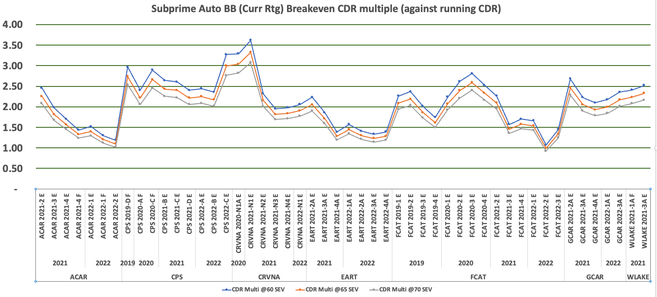
ABS Overview
Sector Review
Installment Loan Analytics
Sector Review – Subprime Auto
Sector Review – Consumer Loan
Subprime Auto Sub IG Opportunity Set
Overall, there is cushion for BB bond to pull back to par even for bearish case (for example CDR worsen from here and severity goes higher)
Different implication on shelf --> CPS, GCAR preferable. Carvana (neutral. Corporate and headline / liquidity risk)
Seasoned 2021 good bonds even 200-300 bps tighter (way much cushion)
Severity not a big needle mover here

Slide 10
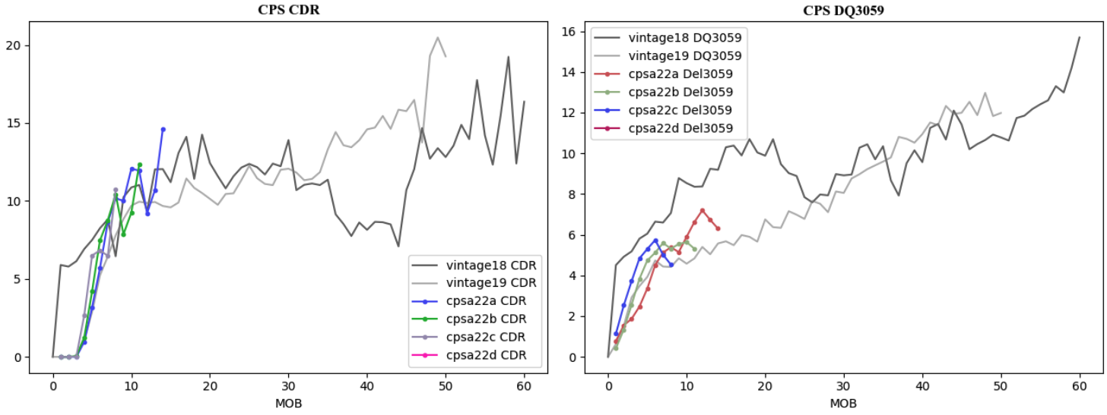
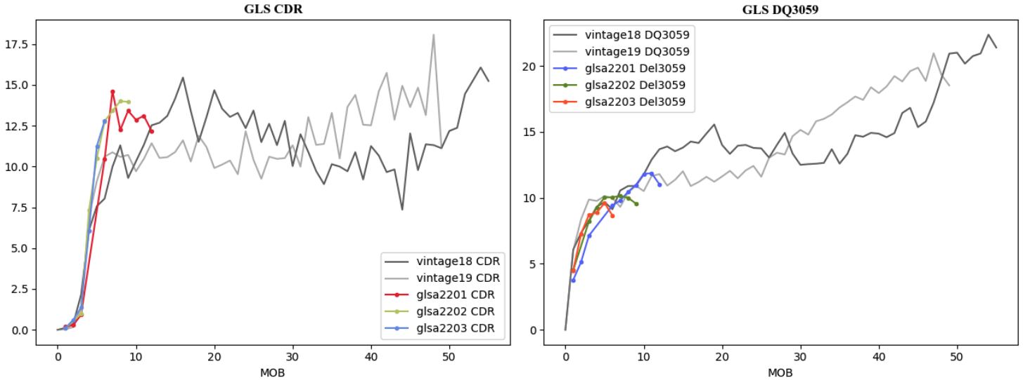
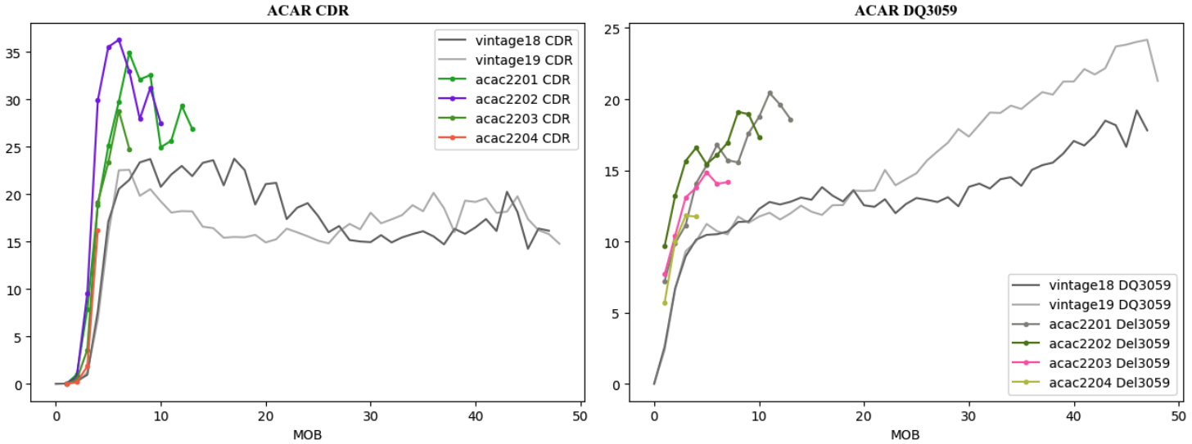
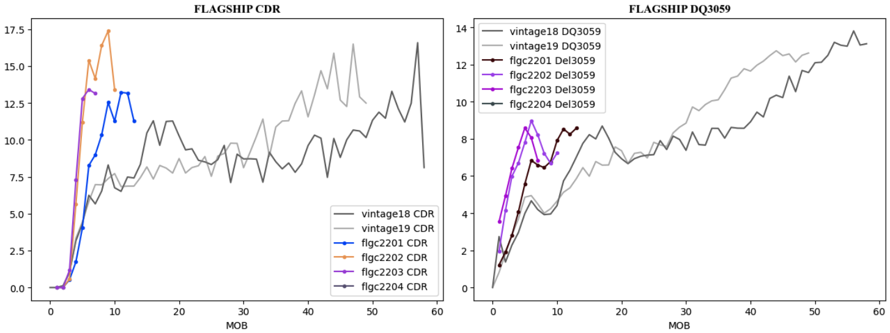
ABS Overview
Sector Review
Installment Loan Analytics
Sector Review – Subprime Auto
Sector Review – Consumer Loan
Outperforming shelves
Underperforming shelves

Slide 11
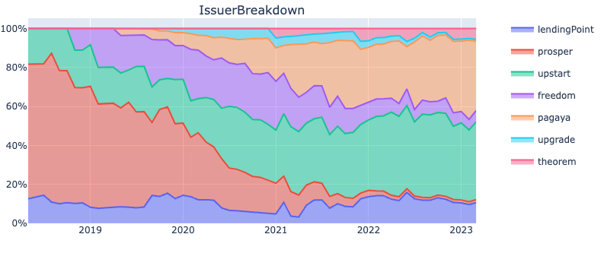
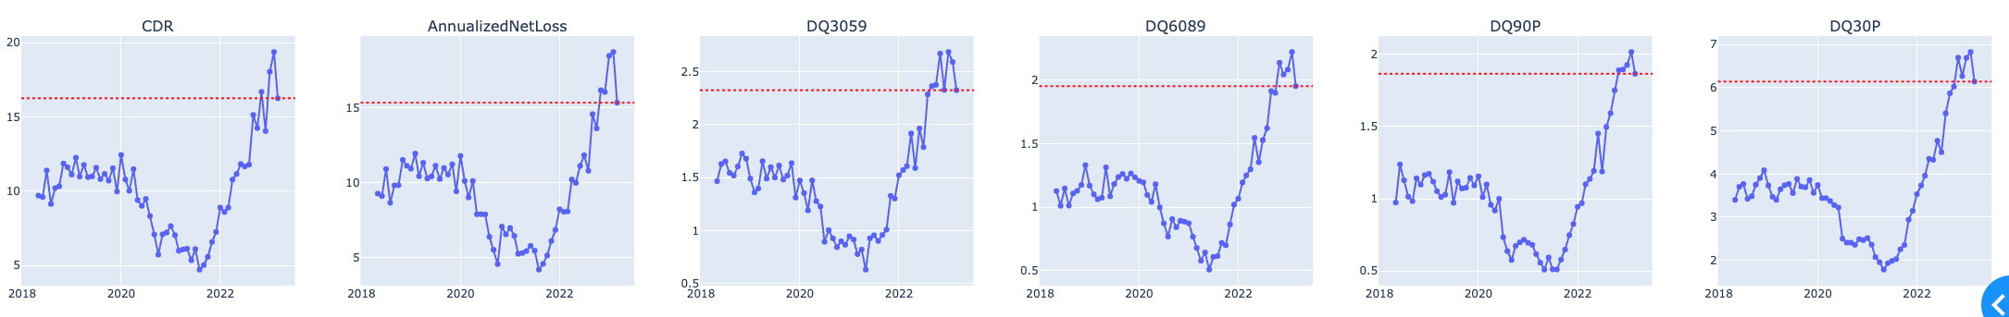
ABS Overview
Sector Review
Installment Loan Analytics
Sector Review – Subprime Auto
Sector Review – Consumer Loan
Consumer Loan Credit Trend
Credit worsening more pronounced than subprime Auto
March 2023 remits shows that Q1 2023 worsening slows down though the credit measurement still elevated
Again, like subprime auto, need more data points to prove out given the uncertain economic tape
Issuer breakdown (from ABS)
Upstart and Pagaya represent > 80% (lower credit cohort player → in line with broader inflation / economics theme)
Actionable insight: move up to higher credit

Slide 12
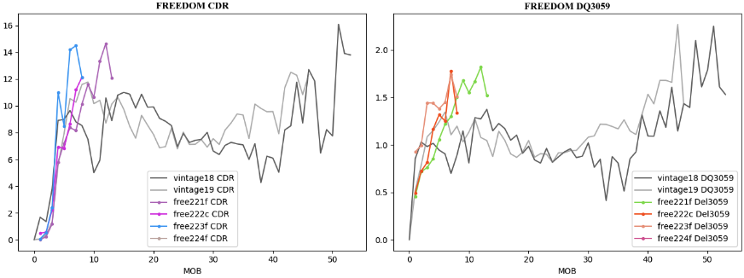
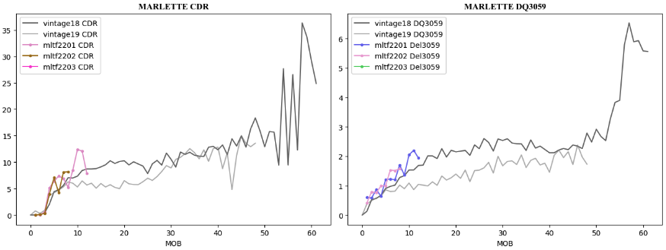
ABS Overview
Sector Review
Installment Loan Analytics
Sector Review – Subprime Auto
Sector Review – Consumer Loan
Consumer Loan Opportunity Set in Higher FICO Cohort
As mentioned, inflation hit disproportionately lower income population
Consumer Loan ABS issuer mostly on <660 cohort; selective issuers in >700 fico cohort
Given soft credit and uncertain economic tape, pass lower FICO cohort and revolving structure
Potential opportunity: move up credit score cohort in collateral, looking for lower capital stack (BBB or BB)
Issuer example: Marlette, Achieve, Bankers Health Group

Slide 13
ABS Overview
Sector Review
Installment Loan Analytics
Sector Review – Subprime Auto
Sector Review – Consumer Loan
Consumer Loan: BHG 2023-1 Example
BHG 2023-1 Trade Example
M700s FICO, $250+k average income (top quintile)
75% commercial loans (majority to highly skilled licensed medical professionals, loans secured by UCC-1 on business assets of borrowers); 25% consumer loans (personal guaranty)
16% WAC, 8yr orig term, $80k avg loan size
Withstands 3x CDR
Downside: 6.5yr long duration; potentially dollar price could move meaningfully down if rate hike / selloff continue, which is not likely though

Slide 14
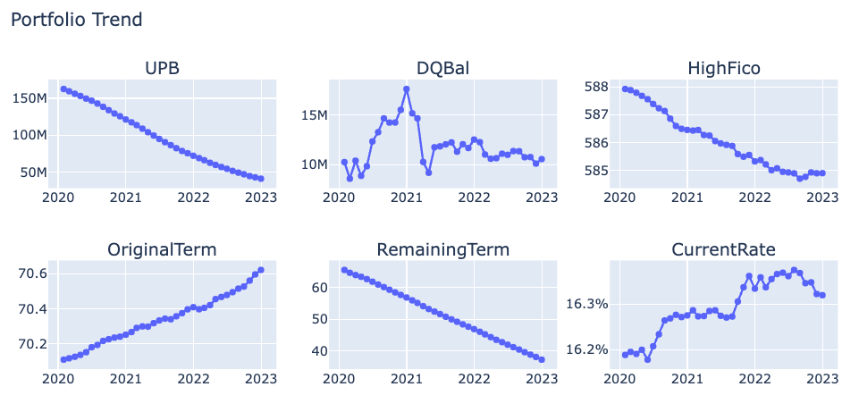
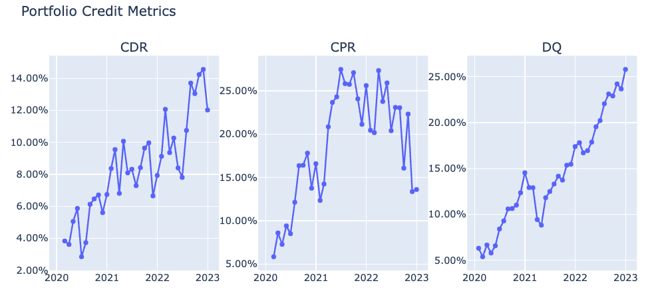
ABS Overview
Sector Review
Installment Loan Analytics
Installment Loan Analytics – Portfolio Description
Installment Loan Analytics – Roll Rate Modeling and Cashflow Forecast
Desk will get access of whole loan portfolio bid opportunity from originators or secondary market → need to build proprietary procedure to evaluate portfolio value and make risk assessment
Case Study: $41mm UPB subprime auto portfolio. Seasoned about 36mo
How to model prepay / default / DQ?
Valuation / bid $px of the pool (clearly different approach than eyeballing and extrapolate curves)
Loan Tape Data Source: personal access from other private credit platforms

Slide 15
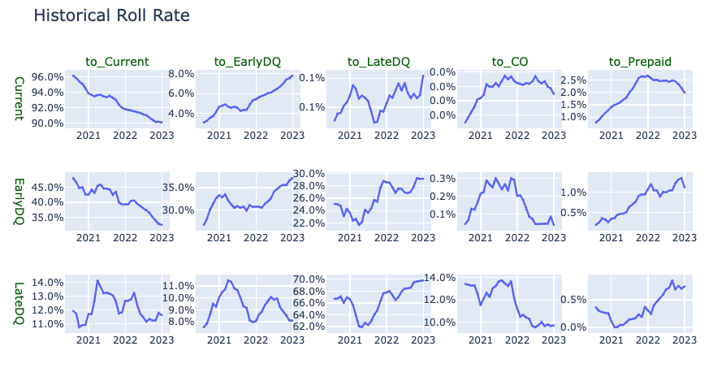
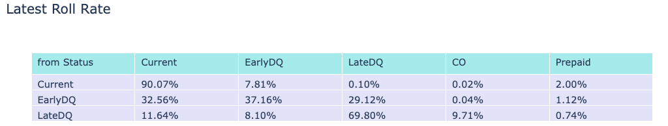
ABS Overview
Sector Review
Installment Loan Analytics
Installment Loan Analytics – Portfolio Description
Installment Loan Analytics – Roll Rate Modeling and Cashflow Forecast
Roll Rate Model Build
Step 1: EDA (Exploratory Data Analysis) – Portfolio Roll Rate Trend
Roll Rate historical revealed more insight than pure CDR / CPR / DQ curves
Roll Rate overall changed over time from early 2020 to end 2022
Factors including portfolio seasoning, credit / macro regime switch, specific credit / loan features
Current → current dropped from 96% to 92%, Current → Early DQ from sub 4% to >8%
Early DQ → Current dropped from 48% to 33%; Early DQ → Early DQ surged from 26% to 37%
Latest Roll Rate is as of Dec 2022, and looking back 6mo, weighted average
Loan Tape Data Source: personal access from other private credit platforms

Slide 16
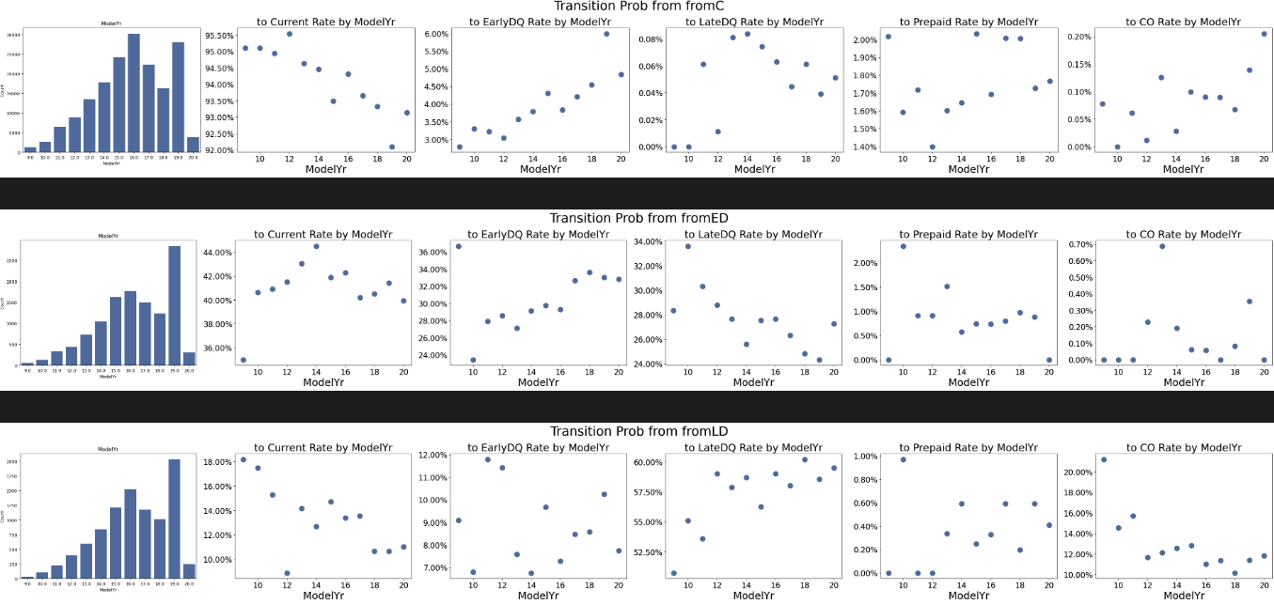
ABS Overview
Sector Review
Installment Loan Analytics
Installment Loan Analytics – Portfolio Description
Installment Loan Analytics – Roll Rate Modeling and Cashflow Forecast
Step 2: Features Selection (check features against roll rate)
Loan Features: MOB, Factor, Term, Int Rate, Orig Bal etc.
Borrower / Credit Features: FICO, BookTier, DTI, PTI, Vechile Model Yr etc.
Macro Variables: Unemployment Rate, Savings Rate, short term funding rate etc..
Loan Tape Data Source: personal access from other private credit platforms

Slide 17
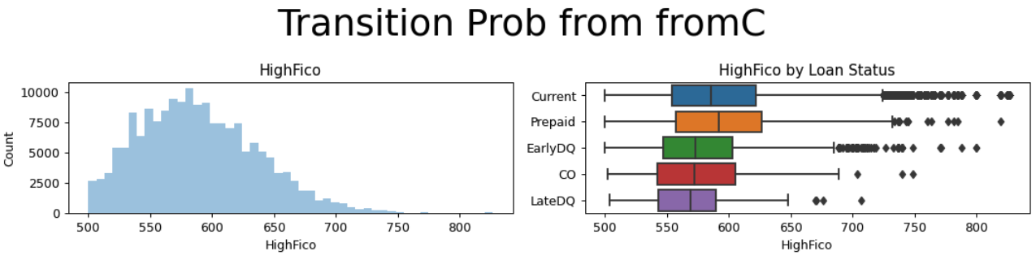
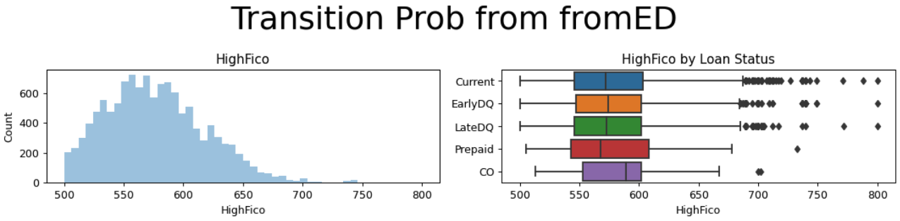
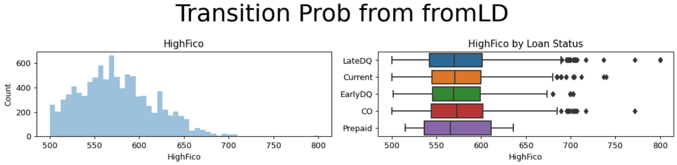
ABS Overview
Sector Review
Installment Loan Analytics
Installment Loan Analytics – Portfolio Description
Installment Loan Analytics – Roll Rate Modeling and Cashflow Forecast
Step 2: Features Selection… continue (example on the right)
Step 3: Fit model and iterate through features selection (fine tuning)
Build Logistic Regression for fromC, fromED, fromLD dataset (i.e. three multinomial logistic regression model)
Evaluate the model against test set and check how well model performs
Finetuning predictor
Select in / out
Bucket (if not bucket, for example FICO, it will require quite expensive computing in amortization schedule step)
Step 4: Apply finished model on current portfolio
Build Logistic Regression for fromC, fromED, fromLD dataset (i.e. three multinomial logistic regression model)
Model out amortization schedule for existing portfolio (by bucket / repline)
Apply transition matrix to each repline for each period of amortization
Calculate cashflow for each repline and combine together
Loan Tape Data Source: personal access from other private credit platforms

Slide 18
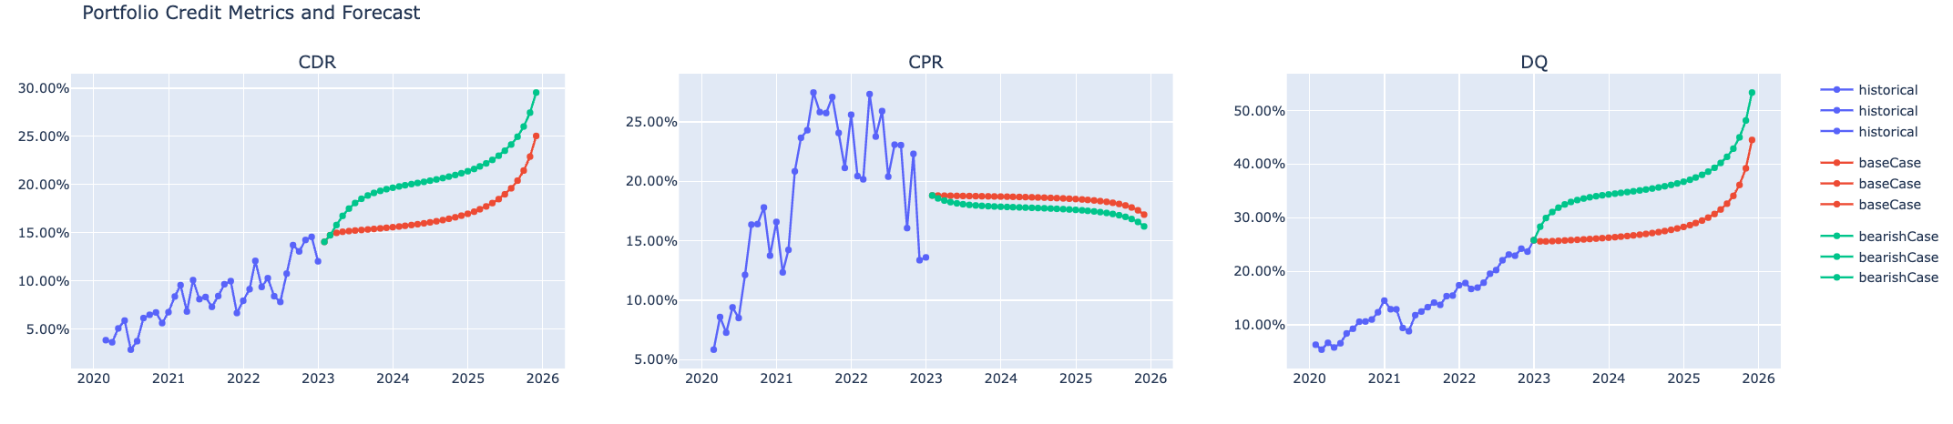
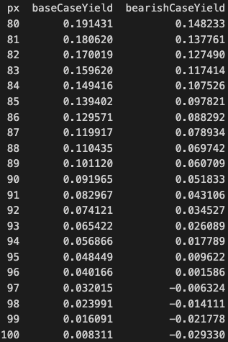
ABS Overview
Sector Review
Installment Loan Analytics
Installment Loan Analytics – Portfolio Description
Installment Loan Analytics – Roll Rate Modeling and Cashflow Forecast
Yield Table
Base case model + shock on savings rate comes with bearish case → on average imply 3% prob jump on transition matrix
Implied CDR in both base case and bearish case continue climb to lm20s to m20s
Bearish case is not out of the table, as the trajectory sort of matches the surging trend of historical DQ build up
Par bid on outstanding portfolio should be flat or slightly down yield (-3%)
15% yield implies portfolio px at low 80s (which I think is prob the current market)
Loan Tape Data Source: personal access from other private credit platforms

